Slide 1
Link Layer Communication
Unit 3

Slide 2
Link Layer Communication
The data link layer is Layer 2 in the OSI architecture model for a set of telecommunication protocols.
Data bits are encoded, decoded and organized in the data link layer, before they are transported as frames between two adjacent nodes on the same LAN or WAN.
The data link layer also determines how devices recover from collisions that may occur when nodes attempt to send frames at the same time.
The data link layer has two sub-layers: the logical link control (LLC) sub-layer and the media access control (MAC) sub-layer.

Slide 3
Link Layer Communication
Functions of the data link layer
1. It handles problems that occur as a result of bit transmission errors.
2. It ensures data flows at a pace that doesn't overwhelm sending and receiving devices.
3. It permits the transmission of data to Layer 3, the network layer, where it is addressed and routed.
Services provided by data link layer:
1.Framing
2.Flow Control
3.Error Control
4.Congestion Control

Slide 4
Error detection and correction techniques
Errors
When bits are transmitted over the computer network, they are subject to get corrupted due to interference and network problems.
The corrupted bits leads to spurious data being received by the destination and are called errors.
Types Of Errors
Single-Bit Error
Multiple bits error
Burst Error

Slide 5
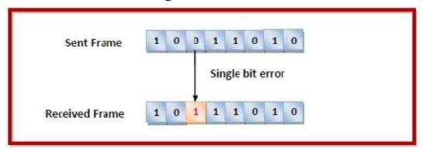
Error detection and correction techniques
Single bit error corrupted, i.e. either changed from 0 to 1 or from 1 to 0.
Single-Bit Error does not appear more likely in Serial Data Transmission.
Single-Bit Error mainly occurs in Parallel Data Transmission.
Ex: If eight wires are used to send the eight bits of a byte, if one of the wire is noisy, then single-bit is corrupted per byte.

Slide 6
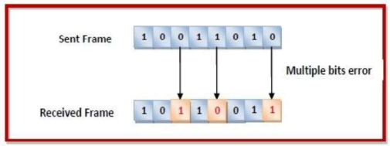
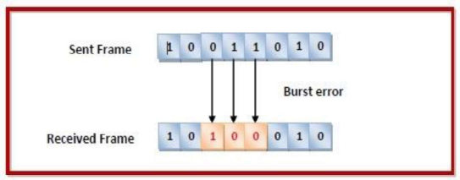
Error detection and correction techniques
Multiple bits error: In the received frame, more than one bits are corrupted.
Burst error : In the received frame, more than one consecutive bits are corrupted.

Slide 7
Error detection and correction techniques
Error Control
Error control can be done in two ways.
Error detection - Error detection involves checking whether any error has occurred or not. The number of error bits and the type of error does not matter.
Error correction – Error correction involves ascertaining the exact number of bits that has been corrupted and the location of the corrupted bits.
For both error detection and error correction, the sender needs to send some additional bits along with the data bits.
The receiver performs necessary checks based upon the additional redundant bits.
If it finds that the data is free from errors, it removes the redundant bits before passing the message to the upper layers

Slide 8
Error detection and correction techniques
Error Detection Techniques :
There are three main techniques for detecting errors in frames:
1. Parity Check
2. Checksum and
3. Cyclic Redundancy Check (CRC)

Slide 9
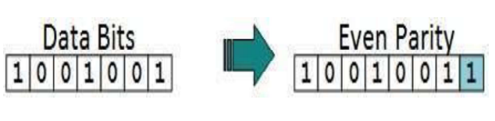
Error detection and correction techniques
1. Parity Check
The parity check is done by adding an extra bit, called parity bit to the data to make a number of 1s either even in case of even parity or odd in case of odd parity.
While creating a frame, the sender counts the number of 1s in it and adds the parity bit in the following way

Slide 10
Error detection and correction techniques
Parity Check
Even parity: If a number of 1s is even then parity bit value is 0. If the number of 1s is odd then parity bit value is 1.
Odd parity: If a number of 1s is odd then parity bit value is 0. If a number of 1s is even then parity bit value is 1.
On receiving a frame, the receiver counts the number of 1s in it.
In case of even parity check, if the count of 1s is even, the frame is accepted, otherwise, it is rejected.
A similar rule is adopted for odd parity check. The parity check is suitable for single bit error detection only.

Slide 11
Error detection and correction techniques
Single Parity Check
In this technique, a redundant bit is also known as a parity bit which is appended at the end of the data unit so that the number of 1s becomes even. Therefore, the total number of transmitted bits would be 9 bits.
If the number of 1s bits is odd, then parity bit 1 is appended and if the number of 1s bits is even, then parity bit 0 is appended at the end of the data unit.
At the receiving end, the parity bit is calculated from the received data bits and compared with the received parity bit.
This technique generates the total number of 1s even, so it is known as even parity checking

Slide 12
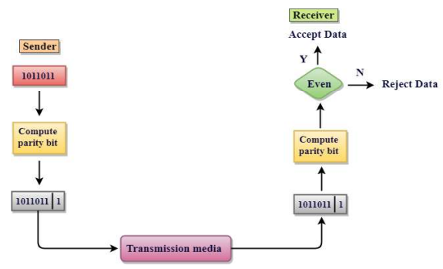
Error detection and correction techniques
Single Parity Check
Drawbacks Of Single Parity Checking
It can only detect single-bit errors which are very rare.
If two bits are interchanged, then it cannot detect the errors

Slide 13
Error detection and correction techniques
Two-Dimensional Parity Check
Performance can be improved by using Two-Dimensional Parity Check which organizes the data in the form of a table.
Parity check bits are computed for each row, which is equivalent to the single-parity check.
Here, a block of bits is divided into rows, and the redundant row of bits is added to the whole block.
At the receiving end, the parity bits are compared with the parity bits computed from the received data

Slide 14
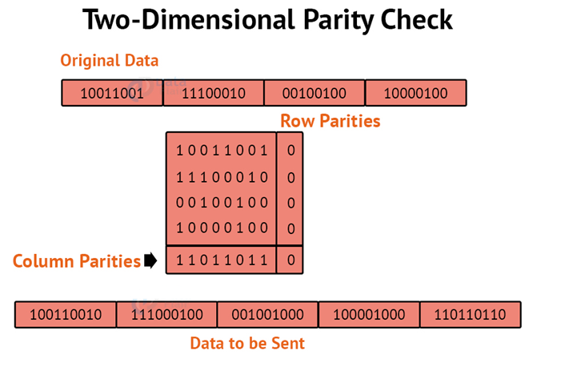
Error detection and correction techniques

Slide 15
Error detection and correction techniques
Drawbacks Of 2D Parity Check
If two bits in one data unit are corrupted and two bits exactly the same position in another data unit are also corrupted, then 2D Parity checker will not be able to detect the error.
This technique cannot be used to detect the 4-bit errors or more in some cases.

Slide 16
Error detection and correction techniques
2. Checksum
A Checksum is an error detection technique based on the concept of redundancy.
It is divided into two parts:
1. Checksum Generator
2. Checksum Checker
Here, Data is divided into fixed sized frames or segments.
The sender adds the segments using 1’s complements arithmetic to get the sum. It then complements the sum to get the checksum and sends it along with the data frames.
The receiver adds the incoming segments along with the checksum using 1’s complement arithmetic to get the sum and then complements it. If the result is zero, the received frames are accepted; otherwise, they are discarded

Slide 17
Error detection and correction techniques
Checksum
The sender follows following steps:
The block unit is divided into k sections, and each of n bits.
All the k sections are added together by using 1’s Complement to get the sum.
The sum is complimented and it becomes the checksum field.
The original data and checksum field are sent across the network.

Slide 18
Error detection and correction techniques
Checksum Checker
A Checksum is verified at the receiving side. The receiver subdivides the incoming data into equal segments of n bits each, and all these segments are added together, and then this sum is complemented. If the complement of the sum is zero, then the data is accepted otherwise data is rejected.
The Receiver follows the given steps:
The block unit is divided into k sections and each of n bits.
All the k sections are added together by using one's complement algorithm to get the sum.
The sum is complemented.
If the result of the sum is zero, then data is accepted otherwise the data is discarded.

Slide 19
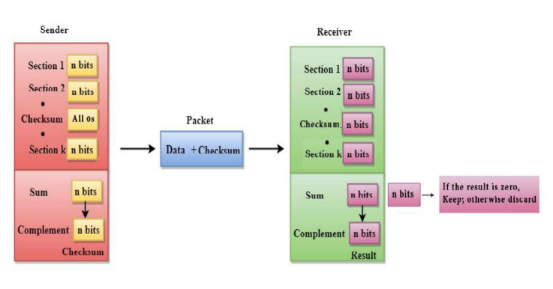
Error detection and correction techniques

Slide 20
Error detection and correction techniques
Example:
Suppose that the sender wants to send 4 frames each of 8 bits, where the frames are 11001100, 10101010, 11110000 and 11000011.
The sender adds the bits using 1s complement arithmetic. While adding two numbers using 1s complement arithmetic, if there is a carry over, it is added to the sum.
After adding all the 4 frames, the sender complements the sum to get the checksum, 11010011, and sends it along with the data frames.
The receiver performs 1s complement arithmetic sum of all the frames including the checksum. The result is complemented and found to be 0. Hence, the receiver assumes that no error has occurred.

Slide 21
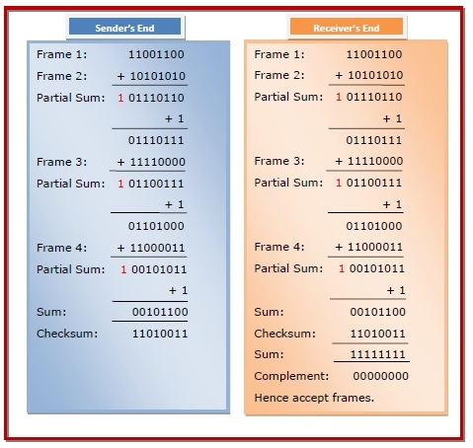
Error detection and correction techniques
Checksum

Slide 22
Error detection and correction techniques
3. Cyclic Redundancy Check (CRC)
CRC is a redundancy error technique used to determine the error.
Following are the steps used in CRC for error detection:
1. A string of n 0s is appended to the data unit, and this n number is less than the number of bits in a predetermined number, known as division which is n+1 bits.
2. The newly extended data is divided by a divisor using a process is known as binary division. The remainder generated from this division is known as CRC remainder

Slide 23
Error detection and correction techniques
Cyclic Redundancy Check (CRC)
3. CRC remainder replaces the appended 0s at the end of the original data. This newly generated unit is sent to the receiver.
4. The receiver receives the data followed by the CRC remainder. The receiver will treat this whole unit as a single unit, and it is divided by the same divisor that was used to find the CRC remainder.

Slide 24
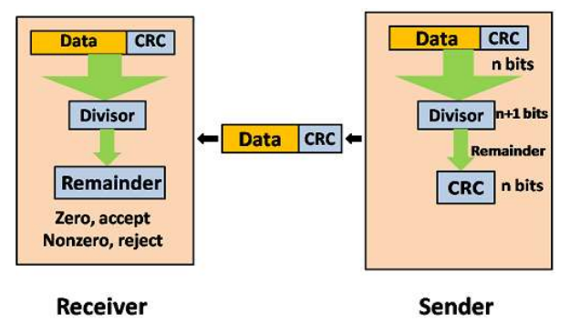
Error detection and correction techniques
If the resultant of this division is zero which means that it has no error, and the data is accepted.
If the resultant of this division is not zero which means that the data consists of an error. Therefore, the data is discarded.

Slide 25
Error detection and correction techniques
Ex: Suppose the original data is 11100 and divisor is 1001.
CRC Generator:
A CRC generator uses a modulo-2 division. Firstly, three zeroes are appended at the end of the data as the length of the divisor is 4 and we know that the length of the string 0s to be appended is always one less than the length of the divisor.
Now, the string becomes 11100000, and the resultant string is divided by the divisor 1001.
The remainder generated from the binary division is known as CRC remainder. The generated value of the CRC remainder is 111.
CRC remainder replaces the appended string of 0s at the end of the data unit, and the final string would be 11100111 which is sent across the network.

Slide 26
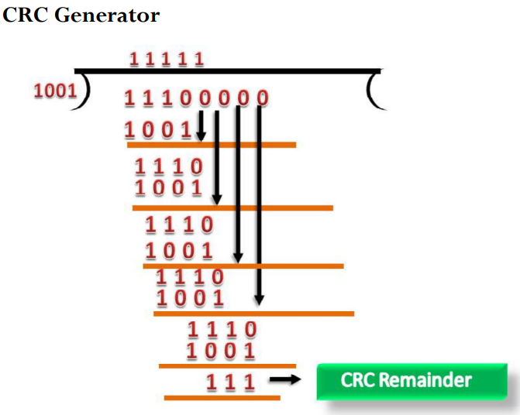
Error detection and correction techniques

Slide 27
Error detection and correction techniques
CRC Checker
The functionality of the CRC checker is similar to the CRC generator.
When the string 11100111 is received at the receiving end, then CRC checker performs the modulo-2 division.
A string is divided by the same divisor, i.e., 1001.
In this case, CRC checker generates the remainder of zero. therefore, the data is accepted.

Slide 28
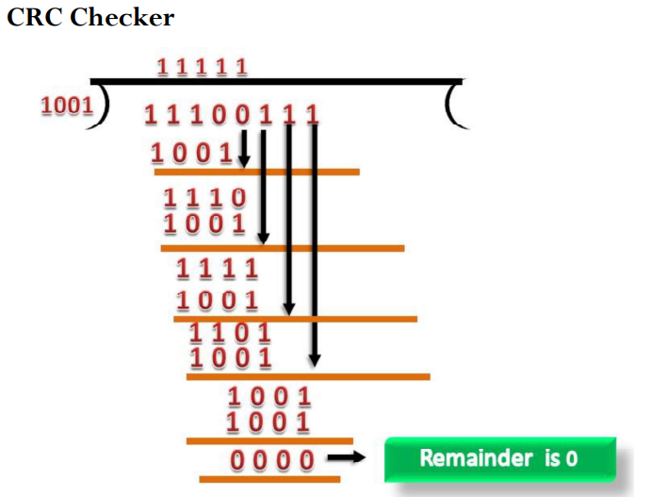
Error detection and correction techniques

Slide 29
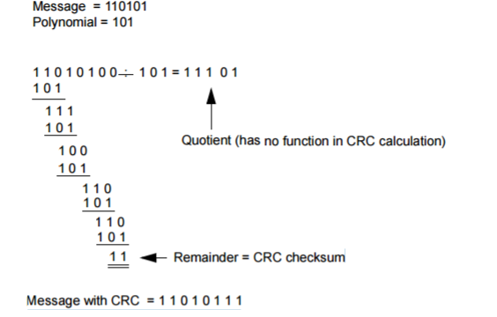
Examples
Message = 110101 Polynomial = 101
FIND CRC?

Slide 30
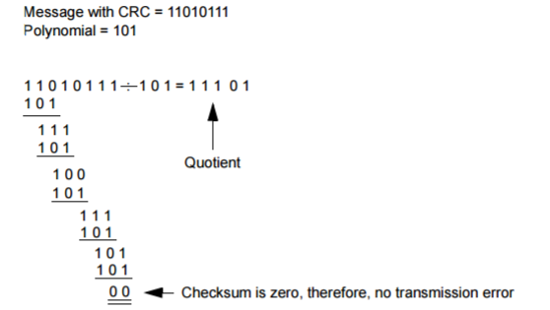
Examples
Message with CRC = 11010111
Polynomial = 101
Check if error in the message at the receiver side.

Slide 31
Examples
Message with CRC = 11010011
Polynomial = 101
Check if error in the message at the receiver side.

Slide 32
Framing
Frames are the units of digital transmission, particularly in computer networks and telecommunications.
Frames are comparable to the packets of energy called photons in the case of light energy.
Framing is a point-to-point connection between two computers or devices consists of a wire in which data is transmitted as a stream of bits.
However, these bits must be framed into discernible blocks of information.
Framing is a function of the data link layer. It provides a way for a sender to transmit a set of bits that are meaningful to the receiver.

Slide 33
Framing
Ethernet, token ring, frame relay, and other data link layer technologies have their own frame structures.
Frames have headers that contain information such as error-checking codes.
At the data link layer, it extracts the message from the sender and provides it to the receiver by providing the sender’s and receiver’s addresses.
The advantage of using frames is that data is broken up into recoverable chunks that can easily be checked for corruption.
The process of dividing the data into frames and reassembling it is transparent to the user and is handled by the data link layer.
Framing is an important aspect of data link layer protocol design because it allows the transmission of data to be organized and controlled, ensuring that the data is delivered accurately and efficiently.

Slide 34
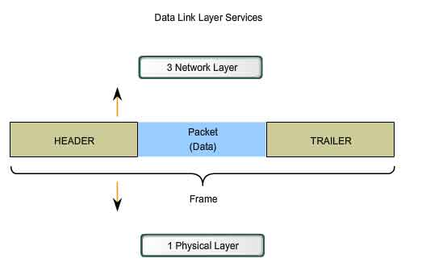
Frame

Slide 35
Formatting Data for Transmission
When data travels on the media, it is converted into a stream of bits, or 1s and 0s.
If a node is receiving long streams of bits, how does it determine where a frame starts and stops or which bits represent the address?
Typical field types include:
Start and stop indicator fields - The beginning and end limits of the frame
Naming or addressing fields
Type field - The type of PDU contained in the frame
Quality - control fields
A data field -The frame payload (Network layer packet)
Fields at the end of the frame form the trailer.
These fields are used for error detection and mark the end of the frame.

Slide 36
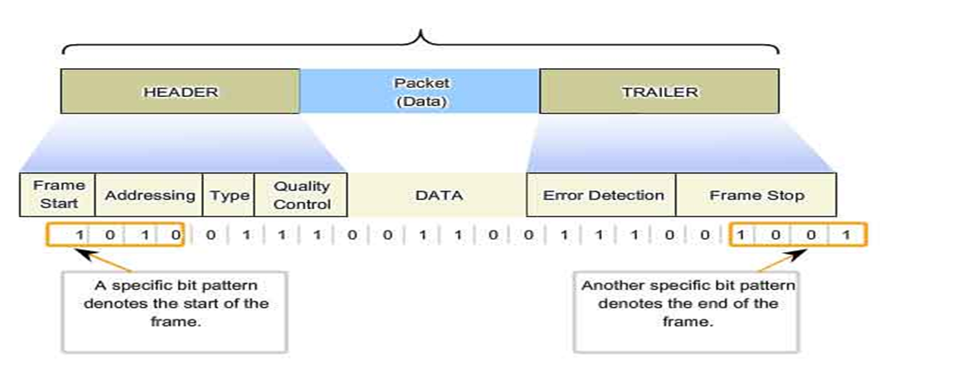
Frame

Slide 37
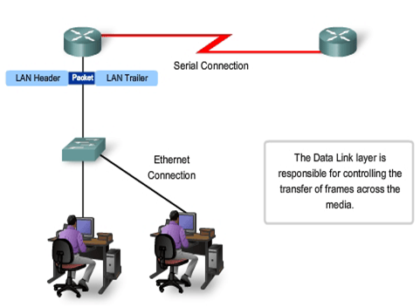
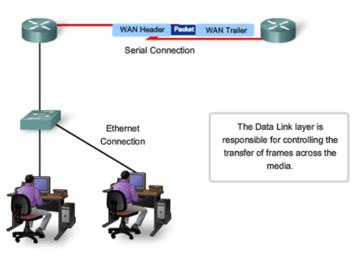
Transfer of frame

Slide 38
Framing and its types
Problems in Framing
Detecting start of the frame: When a frame is transmitted, every station must be able to detect it. Station detects frames by looking out for a special sequence of bits that marks the beginning of the frame i.e. SFD (Starting Frame Delimiter).
How does the station detect a frame: Every station listens to link for SFD pattern through a sequential circuit. If SFD is detected, sequential circuit alerts station. Station checks destination address to accept or reject frame.
Detecting end of frame: When to stop reading the frame.

Slide 39
Types Framing
There are two types of framing:
1. Fixed size – The frame is of fixed size and there is no need to provide boundaries to the frame, the length of the frame itself acts as a delimiter.
Drawback: It suffers from internal fragmentation if the data size is less than the frame size
Solution: Padding

Slide 40
Types Framing
2. Variable size – In this, there is a need to define the end of the frame as well as the beginning of the next frame to distinguish.
This can be done in two ways:
Length field – We can introduce a length field in the frame to indicate the length of the frame. Used in Ethernet(802.3). The problem with this is that sometimes the length field might get corrupted.
End Delimiter (ED) – We can introduce an ED(pattern) to indicate the end of the frame. Used in Token Ring. The problem with this is that ED can occur in the data.
This can be solved by:
1. Character/Byte Stuffing: Used when frames consist of characters. If data contains ED then, a byte is stuffed into data to differentiate it from ED.
Let ED = “$” –> if data contains ‘$’ anywhere, it can be escaped using ‘\O’ character. –> if data contains ‘\O$’ then, use ‘\O\O\O$'($ is escaped using \O and \O is escaped using \O).
Disadvantage – It is very costly method.

Slide 41
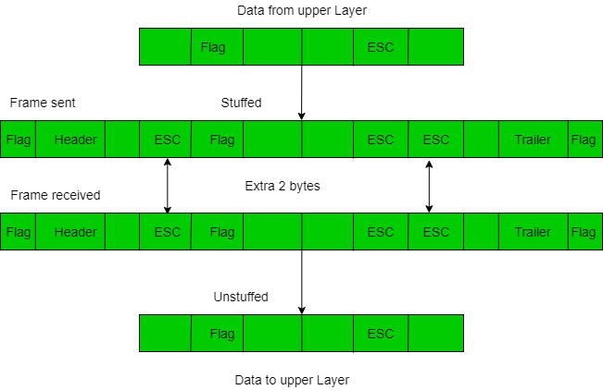
Types Framing

Slide 42
Types Framing
2. Bit Stuffing: Let ED = 01111 and if data = 01111
– Sender stuffs a bit to break the pattern i.e. here appends a 0 in data = 011101. – Receiver receives the frame. – If data contains 011101, receiver removes the 0 and reads the data.
Ex:
If Data –> 011100011110 and ED –> 0111 then, find data after bit stuffing? –> 011010001101100
If Data –> 110001001 and ED –> 1000 then, find data after bit stuffing? –> 11001010011

Slide 43
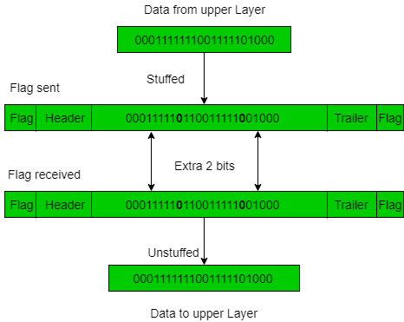
Types Framing

Slide 44
Flow and error control
Flow control and Error control are the two main responsibilities of the Data link layer.
For the node-to-node delivery of the data, the flow and error control are done at the data link layer.

Slide 45
Flow control
Flow control is a technique that allows two stations working at different speeds to communicate with each other.
It is a set of measures taken to regulate the amount of data that a sender sends so that a fast sender does not overwhelm a slow receiver.
In data link layer, flow control restricts the number of frames the sender can send before it waits for an acknowledgment from the receiver.
Flow Control mainly coordinates with the amount of data that can be sent before receiving an acknowledgment from the receiver and it is one of the major duties of the data link layer.

Slide 46
Flow control
The data flow must not be allowed to overwhelm the receiver; because any receiving device has a very limited speed at which the device can process the incoming data and the limited amount of memory to store the incoming data.
The processing rate is slower than the transmission rate; due to this reason each receiving device has a block of memory that is commonly known as buffer, that is used to store the incoming data until this data will be processed.
In case the buffer begins to fillup then the receiver must be able to tell the sender to halt the transmission until once again the receiver become able to receive.
Thus the flow control makes the sender; wait for the acknowledgment from the receiver before the continuation to send more data to the receiver.

Slide 47
Flow control
Approaches of Flow Control
Feedback based Flow Control In these protocols, the sender sends frames after it has received acknowledgments from the user. This is used in the data link layer.
Rate based Flow Control These protocols have built in mechanisms to restrict the rate of transmission of data without requiring acknowledgment from the receiver. This is used in the network layer and the transport layer.

Slide 48
Flow control
Flow Control Techniques in Data Link Layer
Data link layer uses feedback based flow control mechanisms. There are two main techniques are: Stop-and-Wait and sliding window technique.
Stop and Wait:
Stop-and-wait protocol works under the assumption that the communication channel is noiseless and transmissions are error-free.
This protocol involves the following transitions :
The sender sends a frame and waits for acknowledgment.
Once the receiver receives the frame, it sends an acknowledgment frame back to the sender.
On receiving the acknowledgment frame, the sender understands that the receiver is ready to accept the next frame. So it sender the next frame in queue.

Slide 49
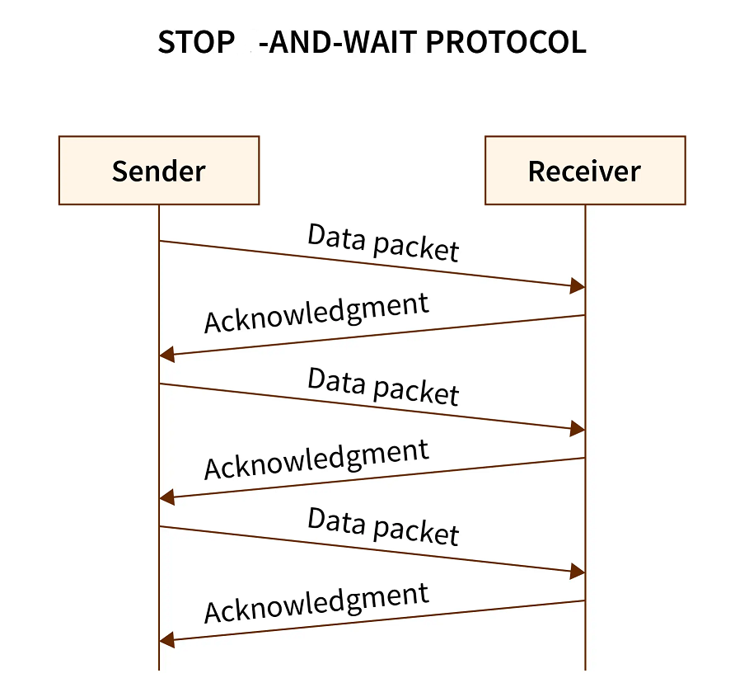
Flow control

Slide 50
Flow control
2. Sliding Window:
This protocol improves the efficiency of stop and wait protocol by allowing multiple frames to be transmitted before receiving an acknowledgment.
The sliding window protocol is the flow control protocol for noisy channels that allows the sender to send multiple frames even before acknowledgments are received.
It is called a Sliding window because the sender slides its window upon receiving the acknowledgments for the sent frames.
The working principle of this protocol can be described as follows :
Both the sender and the receiver has finite sized buffers called windows. The sender and the receiver agrees upon the number of frames to be sent based upon the buffer size.
The sender sends multiple frames in a sequence, without waiting for acknowledgment.
When its sending window is filled, it waits for acknowledgment.
On receiving acknowledgment(ACK), it advances the window and transmits the next frames, according to the number of acknowledgments received.

Slide 51
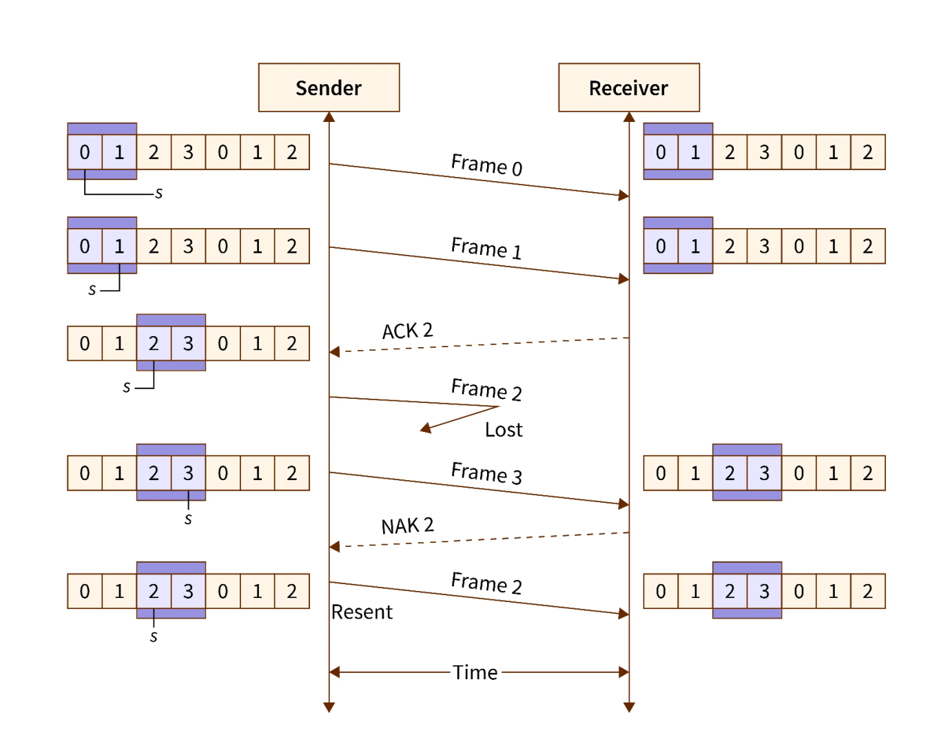
Flow control

Slide 52
Flow control
The sender sends the frames 0 and 1 from the first window (because the window size is 2).
The receiver after receiving the sent frames, sends an acknowledgment for frame 2 (as frame 2 is the next expected frame).
The sender then sends frames 2 and 3. Since frame 2 is lost on the way, the receiver sends back a “NAK” signal (a non-acknowledgment) to inform the sender that frame 2 has been lost. So, the sender retransmits frame 2.

Slide 53
Error control
Error Control contains both error detection and error correction.
It mainly allows the receiver to inform the sender about any damaged or lost frames during the transmission and then it coordinates with the retransmission of those frames by the sender.
The term Error control in the data link layer mainly refers to the methods of error detection and retransmission.
Error control is mainly implemented in a simple way and that is whenever there is an error detected during the exchange, then specified frames are retransmitted and this process is also referred to as Automatic Repeat request(ARQ).

Slide 54
Error control
Error control is a vital function of the data link layer that detects errors in transmitted frames and retransmits all the erroneous frames.
Error discovery and amendment deal with data frames damaged or lost in transit and the acknowledgment frames lost during transmission.
The method used in noisy channels to control these errors is ARQ or Automatic Repeat Request.

Slide 55
Error control
Categories of Error Control
1. Stop-and-wait ARQ
In the case of stop-and-wait ARQ after the frame is sent, the sender maintains a timeout counter.
If acknowledgment of the frame comes in time, the sender transmits the next frame in the queue.
Else, the sender retransmits the frame and starts the timeout counter.
In case the receiver receives a negative acknowledgment, the sender retransmits the frame.

Slide 56
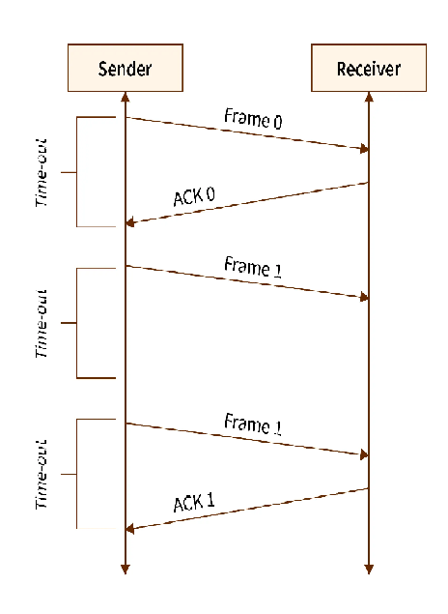
Error control

Slide 57
Error control
2. Sliding Window ARQ
To deal with the retransmission of lost or damaged frames, a few changes are made to the sliding window mechanism used in flow control.
Go-Back-N ARQ :
In Go-Back-N ARQ, if the sent frames are suspected or damaged, all the frames are re-transmitted from the lost packet to the last packet transmitted.

Slide 58
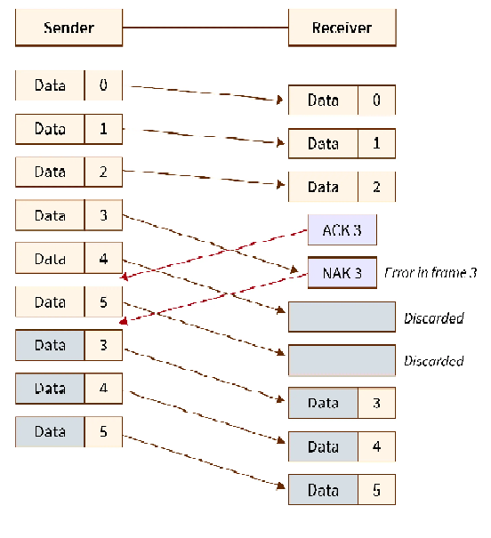
Error control

Slide 59
Error control
ii)Selective Repeat ARQ :
Selective repeat ARQ/ Selective Reject ARQ is a type of Sliding Window ARQ in which only the suspected or damaged frames are re-transmitted.

Slide 60
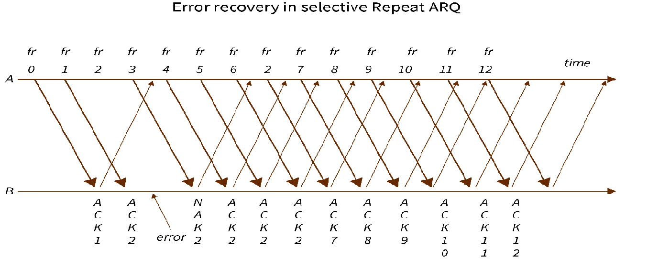
Error control

Slide 61
HDLC protocol
High-level Data Link Control (HDLC) is a group of communication protocols of the data link layer for transmitting data between network points or nodes.
Since it is a data link protocol, data is organized into frames. A frame is transmitted via the network to the destination that verifies its successful arrival.
It is a bit - oriented protocol that is applicable for both point - to - point and multipoint communications.
Transfer Modes:
HDLC supports two types of transfer modes, normal response mode and asynchronous balanced mode.
Normal Response Mode (NRM) − Here, two types of stations are there, a primary station that send commands and secondary station that can respond to received commands. It is used for both point - to - point and multipoint communications.

Slide 62
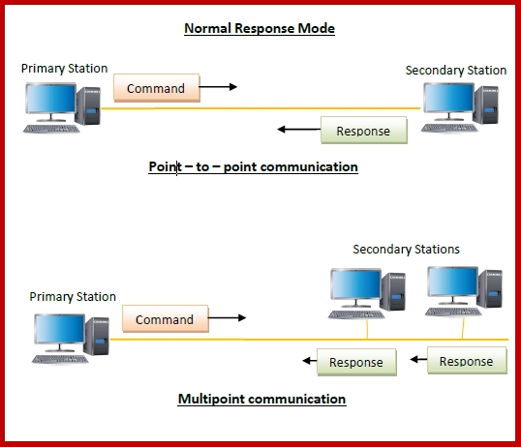
HDLC protocol

Slide 63
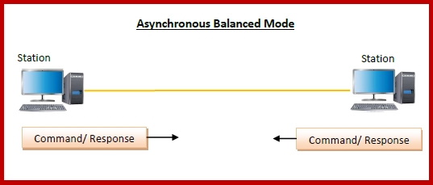
HDLC protocol
Asynchronous Balanced Mode (ABM) − Here, the configuration is balanced, i.e. each station can both send commands and respond to commands. It is used for only point - to - point communications.

Slide 64
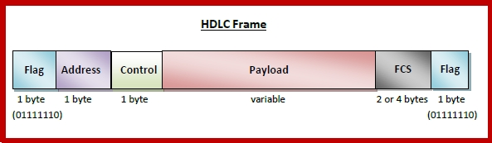
HDLC protocol
HDLC Frame:
HDLC is a bit - oriented protocol where each frame contains up to six fields. The structure varies according to the type of frame. The fields of a HDLC frame are :
Flag − It is an 8-bit sequence that marks the beginning and the end of the frame. The bit pattern of the flag is 01111110.
Address − It contains the address of the receiver. If the frame is sent by the primary station, it contains the address(es) of the secondary station(s). If it is sent by the secondary station, it contains the address of the primary station. The address field may be from 1 byte to several bytes.
Control − It is 1 or 2 bytes containing flow and error control information.
Payload − This carries the data from the network layer. Its length may vary from one network to another.
FCS − It is a 2 byte or 4 bytes frame check sequence for error detection. The standard code used is CRC (cyclic redundancy code)

Slide 65
HDLC protocol
Types of HDLC Frames:
There are three types of HDLC frames. The type of frame is determined by the control field of the frame
I-frame : I-frames or Information frames carry user data from the network layer. They also include flow and error control information that is piggybacked on user data. The first bit of control field of I-frame is 0.
S-frame : S-frames or Supervisory frames do not contain information field. They are used for flow and error control when piggybacking is not required. The first two bits of control field of S-frame is 10.
U-frame : U-frames or Un-numbered frames are used for myriad miscellaneous functions, like link management. It may contain an information field, if required. The first two bits of control field of U-frame is 11.

Slide 66
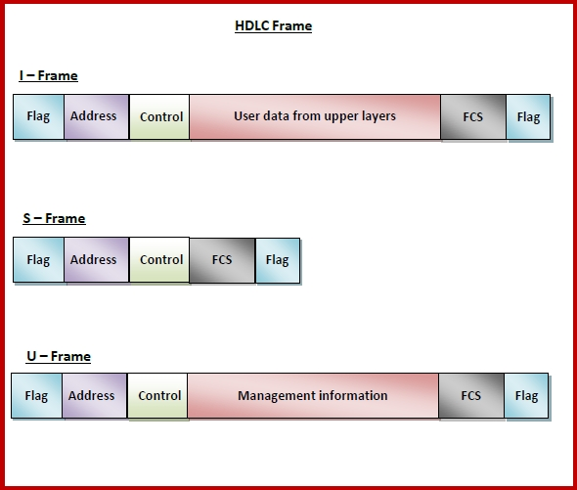
HDLC protocol

Slide 67
P2P Protocol
PPP(Point-To-Point) protocol is a protocol used in the data link layer. The PPP protocol is mainly used to establish a direct connection between two nodes.
The Point-To-Point protocol mainly provides connections over multiple links.
This protocol defines how two devices can authenticate with each other.
PPP protocol also defines the format of the frames that are to be exchanged between the devices.
This protocol also defines how the data of the network layer are encapsulated in the data link frame.
The PPP protocol defines how the two devices can negotiate the establishment of the link and then can exchange the data.
This protocol provides multiple services of the network layer and also supports various network-layer protocols.

Slide 68
P2P Protocol
Services that are not offered by the PPP protocol are as follows:
This protocol does not provide a flow control mechanism. Because when using this protocol the sender can send any number of frames to the receiver one after the other without even thinking about overwhelming the receiver.
This protocol does not provide any mechanism for addressing in order to handle the frames in the multipoint configuration.
The PPP protocol provides a very simple mechanism for error control. There is a CRC field that detects the errors. In case if there is a corrupted frame then it is discarded silently.

Slide 69
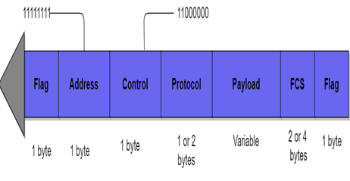
P2P Protocol
PPP Frame Format

Slide 70
P2P Protocol
1. Flag
The PPP frame mainly starts and ends with a 1-byte flag field that has the bit pattern: 01111110. It is important to note that this pattern is the same as the flag pattern used in HDLC. But there is a difference too and that is PPP is a byte-oriented protocol whereas the HDLC is a bit-oriented protocol.
2. Address
The value of this field in PPP protocol is constant and it is set to 11111111 which is a broadcast address. The two parties can negotiate and can omit this byte.
3. Control
The value of this field is also a constant value of 11000000. We have already told you that PPP does not provide any flow control and also error control is limited to error detection. The two parties can negotiate and can omit this byte.
4. Protocol
This field defines what is being carried in the data field. It can either be user information or other information. By default, this field is 2 bytes long.
5. Payload field
This field carries the data from the network layer. The maximum length of this field is 1500 bytes. This can also be negotiated between the endpoints of communication.
6. FCS
It is simply a 2-byte or 4-byte standard CRC(Cyclic redundancy check).

